Slide 1
Deep Learning in R Using Keras
Alex Archer, Data Scientist
Dick’s Sporting Goods

Slide 2
What is Deep Learning?
Deep Learning
So Hot Right Now

Slide 3
Deep Learning
Subset of machine learning that utilizes layered neural networks to learn complex nonlinear relationships in data
“Deep learning enables the computer to build complex concepts out of simpler concepts”¹
By layering simple functions, the model becomes much more flexible
Artificial Intelligence
Machine Learning
Deep Learning

Slide 4
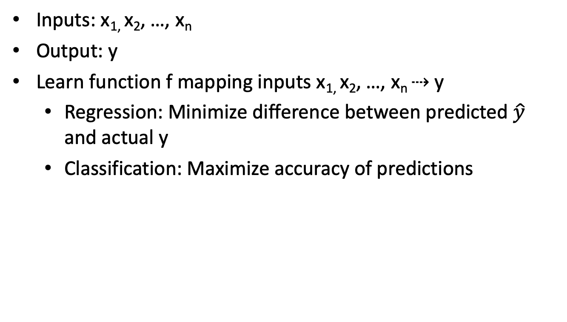
Basic Modeling
Inputs: x_{1,} x₂, …, x_{n}
Output: y
Learn function f mapping inputs x_{1,} x₂, …, x_{n} ⇢ y
Regression: Minimize difference between predicted $\hat{y}$ and actual y
Classification: Maximize accuracy of predictions

Slide 5
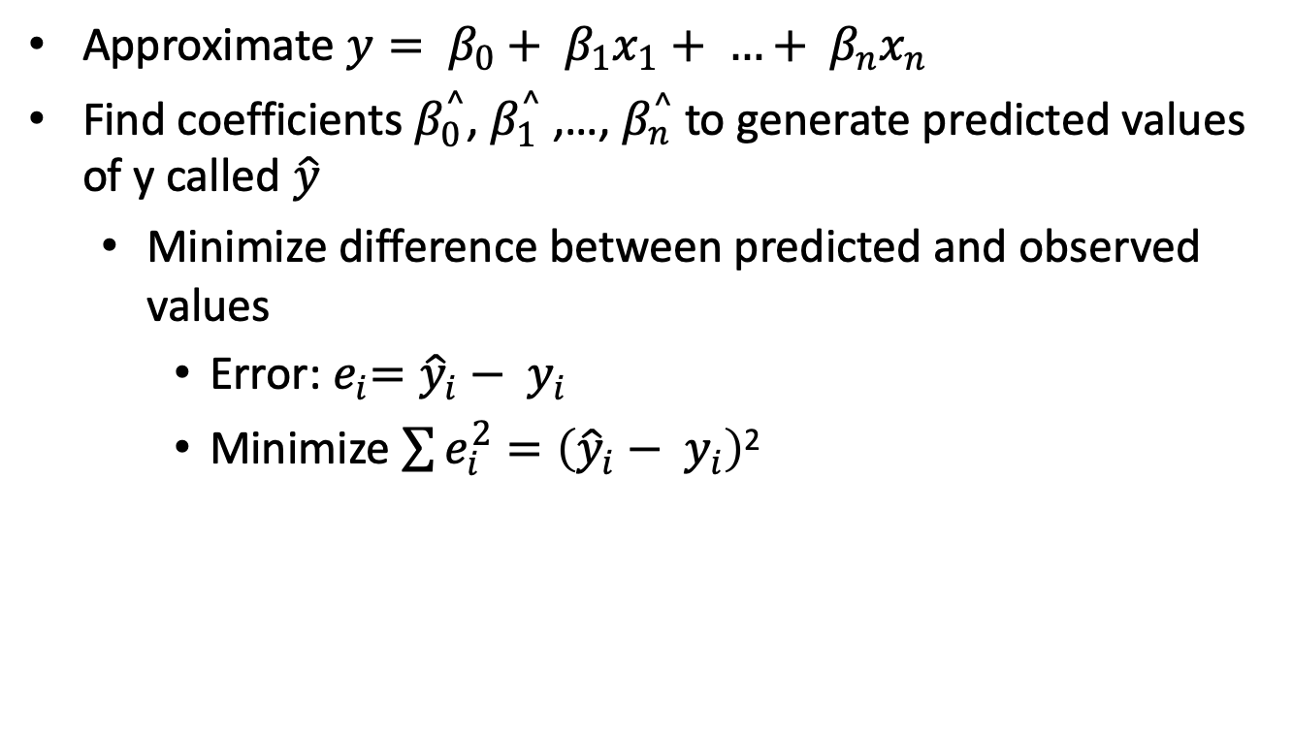
Example: Regression
Approximate $y= β_{0}+ β_{1}x_{1}+ …+ β_{n}x_{n}$
Find coefficients $β_{0}^{^}$, $β_{1}^{^}$ ,…,${ β}_{n}^{^}$ to generate predicted values of y called $\hat{y}$
Minimize difference between predicted and observed values
Error:${ e}_{i}={\hat{y}}_{i}− y_{i}$
Minimize $\sum{e_{i}^{2}}=\left({\hat{y}}_{i}− y_{i}\right)$²

Slide 6
Linear Decision Boundaries

Slide 7
Non-Linear Decision Boundaries

Slide 8
Need a More Complex Model
Deep Learning to the rescue!
The stacked layers give neural networks more flexibility to pick up on complex relationships
See for yourself!
https://playground.tensorflow.org

Slide 9
When to Use Deep Learning
High volume of training data
Working with complex data / features
E.g. image data
Goal is to achieve high accuracy, rather than interpretability
Access to sufficient computing power

Slide 10
What is Keras
What is Keras?
A high level API for deep learning that can run on top of Tensorflow and other libraries
It is designed to be extremely user-friendly
Ability to run on both CPUs and GPUs

Slide 11
Keras Example
Today we will see how a NN can be implemented in Keras for product recommendation
This is not an MNIST dataset problem! ☺
We will work with embedding layers (explained later)
Very simple examples can be found in the Keras documentation:
https://keras.io/
https://keras.rstudio.com/

Slide 12
What Are Embeddings?
Embeddings are a way to represent categorical variables in reduced dimensionality
Often found in Natural Language Processing Domain
E.g. Word2vec
Representing words or categorical variables as one-hot-encoded variables can be problematic in large datasets
Instead we find a way to represent the categorical variables in a reduced dimensionality
This creates interesting properties in our data, as distance becomes meaningful in the new vector space

Slide 13

Product Recommendation - Example
Dicksportinggoods.com #ad

Slide 14
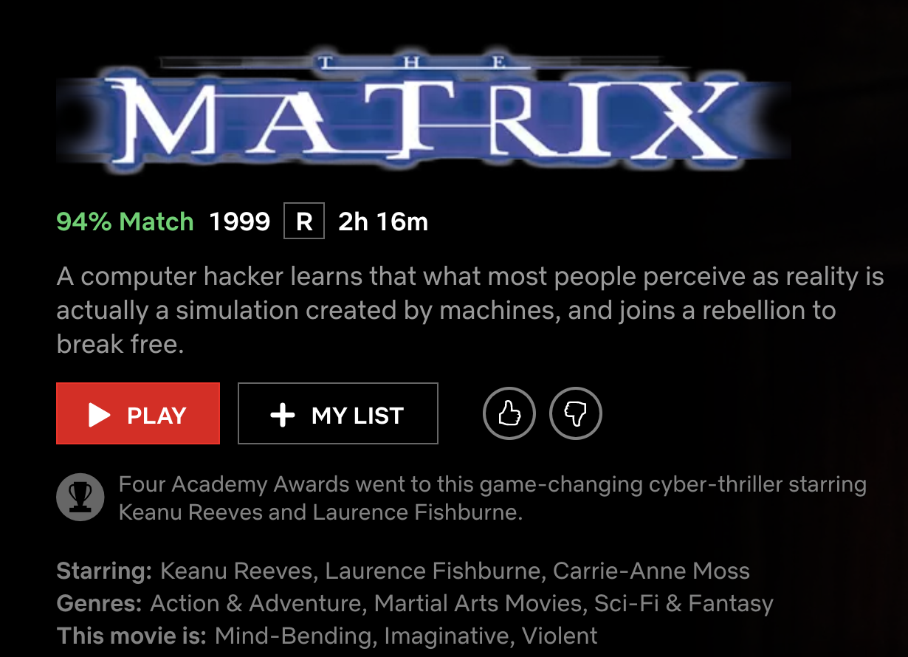
Product Recommendation
Goal: Suggest other items of interest to customer
Exposure to more items will increase revenue
Similar or complementary items
Obvious applications in retail
Similar algorithms are used by social media and entertainment companies:
Netflix, Spotify, etc.

Slide 15
Implicit vs. Explicit Feedback
Explicit Feedback
Direct feedback from customer - ratings, reviews
Netflix Prize
Implicit Feedback
Implied or indirect information from customer
More difficult for modeling, but often more readily available

Slide 16
Methodology
Collect data on customers id and product id for views, cart adds, in-store buys and online buys
Create a metric for scoring customer preference of an item
Think rating in the Netflix problem
Train a neural network that takes the dot product of 2 embedding layers: one for customers and one for products
Input: customer and athlete ids, Predict: score
Extract embedding vector for each item
Make recommendations based on product similarity
i.e. cosine similarity between products in the new space

Slide 17

Rshiny Application

Slide 18
Code and Data
PowerPoint and Rmarkdown available on Github:
https://github.com/alex-archer17/rUsers_keras
Data not posted
But there a few open source datasets posted
Try out the same model using these datasets!
Retail dataset
Song dataset
Joke dataset

Slide 19
Questions, Comments, Praises
Any questions?
Feel free to reach out via email
Alexander.archer@dcsg.com (don’t forget the “c”)
Thank you for your attention!

